Slide 1



ME224 – Kinematics of machinery
Design of Collapsible foot bridge mechanism
By
Rahul Aggarwal
(190103120)

Slide 2
Content of This Project
CAD Model
Simulation Video
Parts Used
Mechanism Used And Their Simulation
DOF Calculation

Slide 3
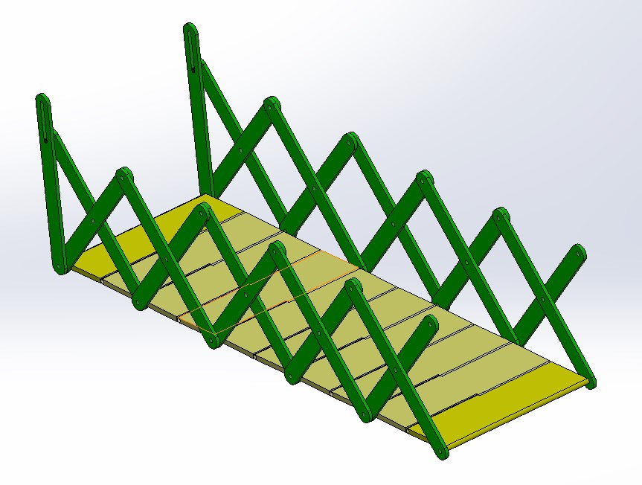
CAD Model
Bridge Unfolded

Slide 4
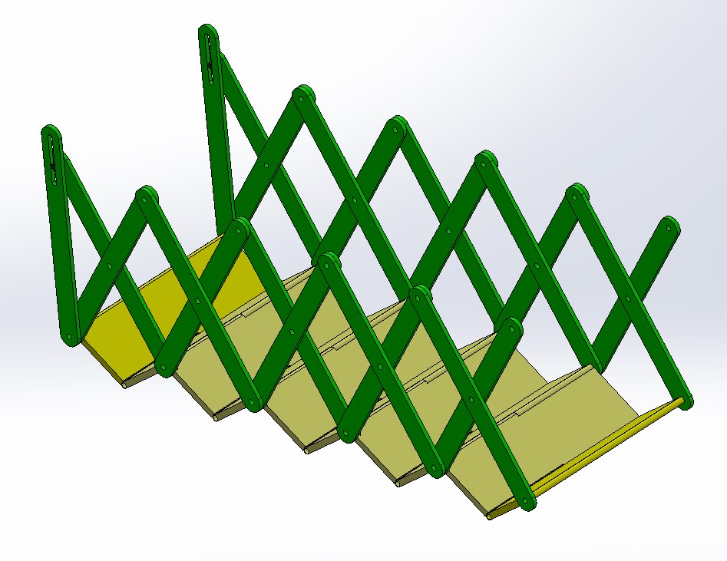
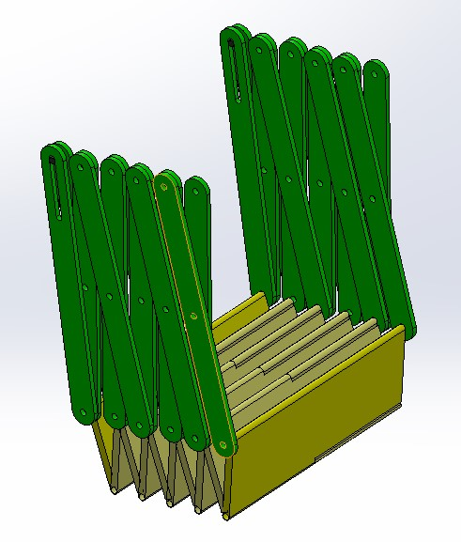
CAD Model
Bridge while folding
Folded Bridge

Slide 5
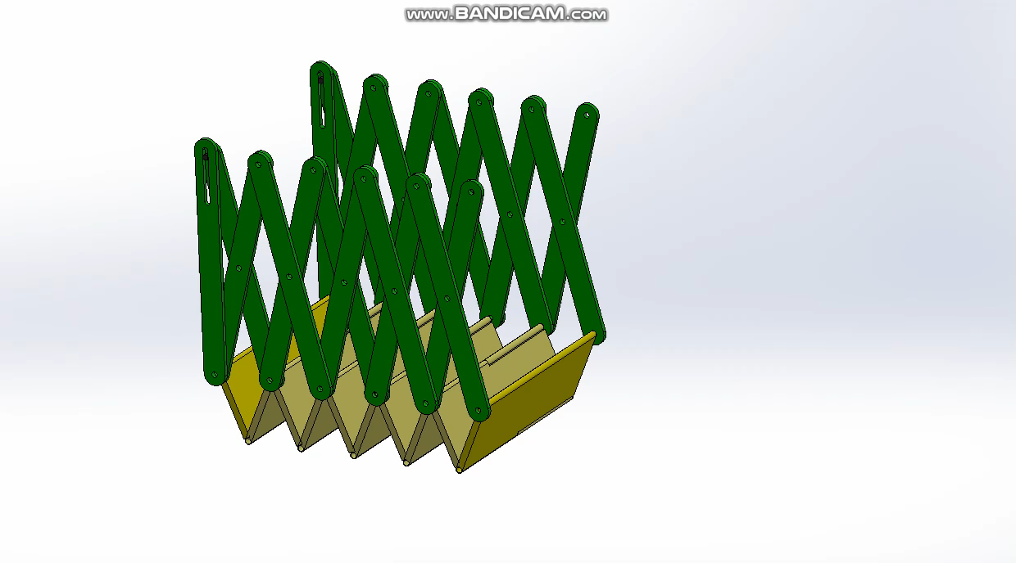
Simulation

Slide 6
Parts Used

Slide 7
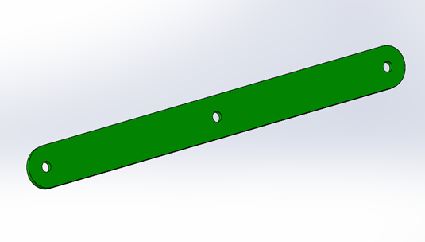
Side Bars for Scissor Mechanism

Slide 8
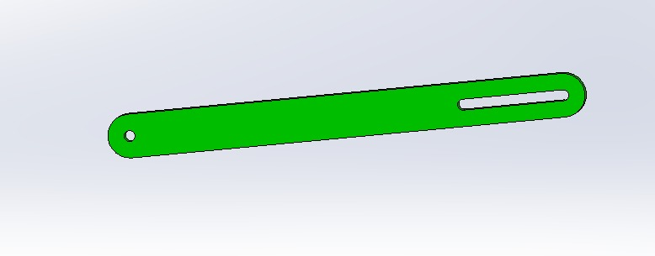
Pin Slot Bar for Scissor Mechanism

Slide 9
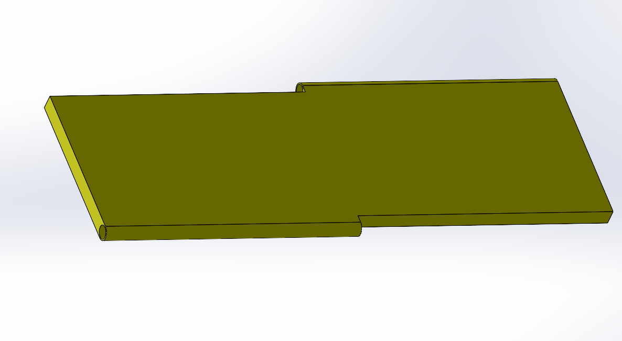
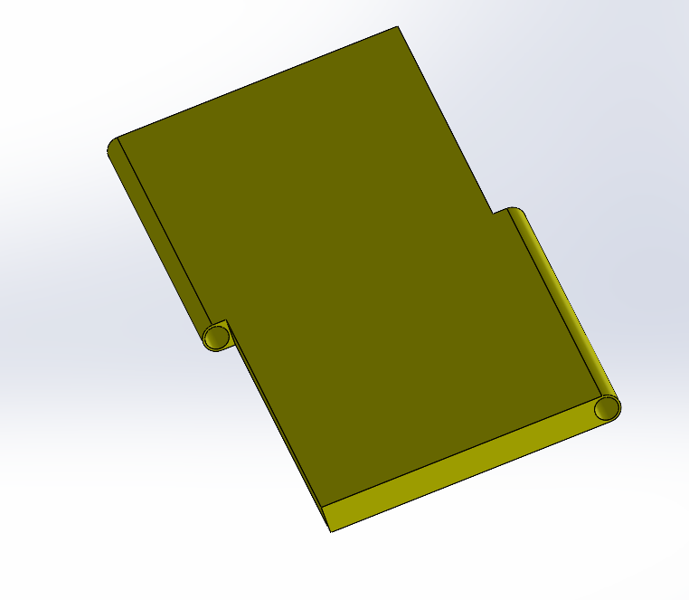
Footpath Base

Slide 10
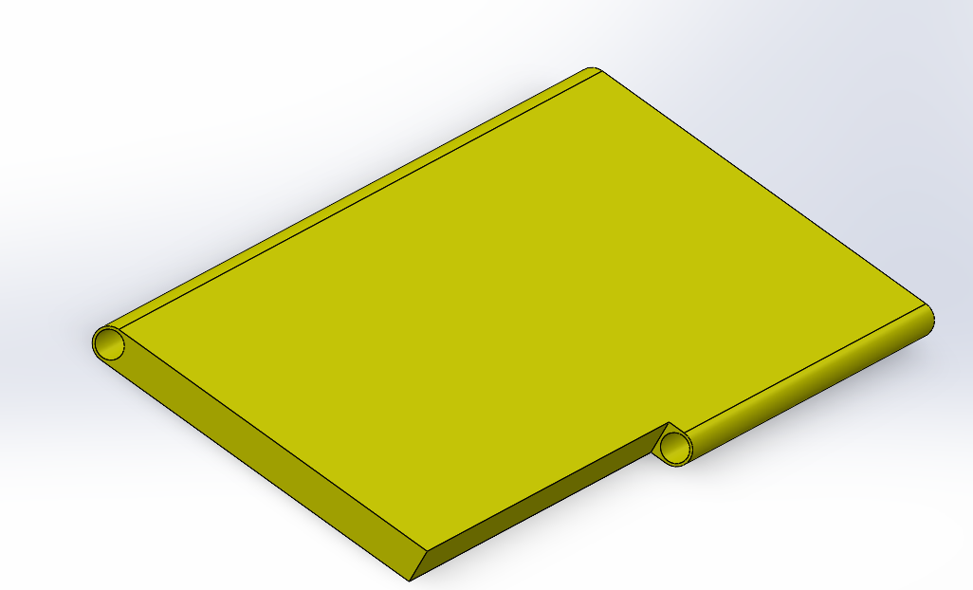
Footpath Start and End Base

Slide 11
Mechanism Used

Slide 12
Scissor Mechanism
This mechanism is used to design the collapsible mechanism of the foot bridge.
A scissor mechanism uses linked, support in a criss – cross pattern. When pressure is put on the extremum support, the cross struts are stretched out which unfolds our bridge.
The driving mechanism for a scissor mechanism can be hydraulic, pneumatic or mechanical (a leadscrew or rack and pinion system).

Slide 13
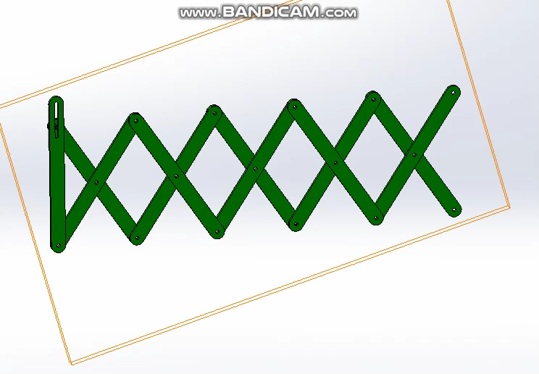
Simulation Video of the scissor mechanism

Slide 14
Pin in a slot mechanism
This mechanism is used to provide the pressure to the scissor bridge to stretch it out.
The external mechanism to provide the necessary pressure to the bridge is attached to this pin such that when it moves in the provided slot, the bridge can fold and unfold.

Slide 15
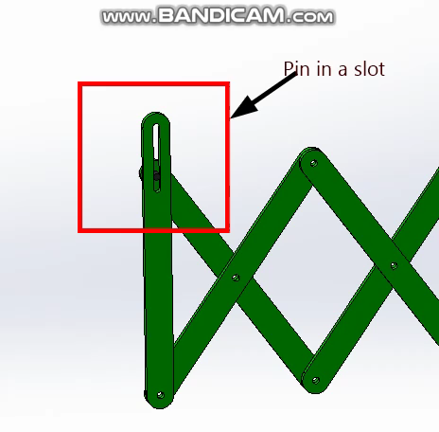
Simulation of the Pin in a slot

Slide 16
Revolute Joints
This joints is used to connect two bars and also two base parts of the bridge. This is the most used joint in our mechanism.

Slide 17
DOF Analysis

Slide 18
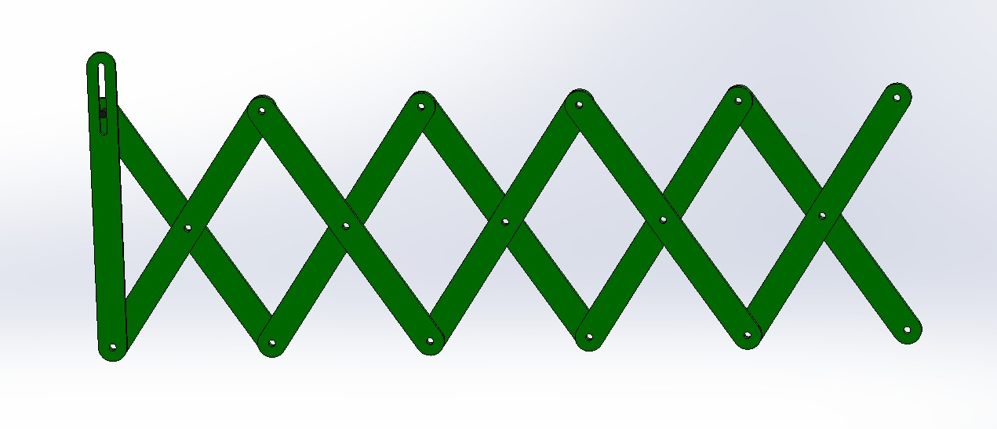
Links
8
10
2
4
6
1
11
3
5
7
9

Slide 19
Revolute Joints
1
9
13
7
6
8
11
14
2
10
12
3,4
5

Slide 20
Pin in a slot Joints
1

Slide 21
Calculations
No. of links (n) = 11
No. of lower pair(P₁) = 14
No. of higher pair(P₂)= 1
This implies:
DOF = 3(n-1) - 2(P₁) – P₂ = 3(11-1) – 2*14 - 1
DOF = 1

Slide 22
Thank You

